Slide 1

MICROSERVICES WITH SPRINGBOOT
By TAKAM TALLA LOIQUE

Slide 2




Who am I ?
I am named Takam Talla LOIQUE DARIOS
Currently an IT Student at ECOLE-IT Bruxelles
Part-Time IT Teacher at LEVEL UP
Backend Engineer intern at IDMTEK
You can follow me on linkedin : Loique Takam

Slide 3
Main Subjects
Why Microservices
Diagram and Usage
Methodology
Testing Services
Back-end for Front-end
Implication of Docker
Conclusion

Slide 4
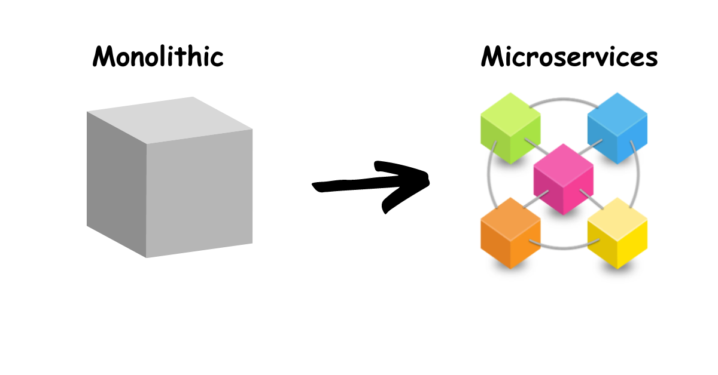
Why Microservices
Microservices architecture is an ideal choice for complex projects such as LinkedIn clone project, which here includes user service, post service, profile service, and BFF. This architectural approach offers the following:
->Scalability
->Modularity
->Flexibility
->Improved team autonomy

Slide 5
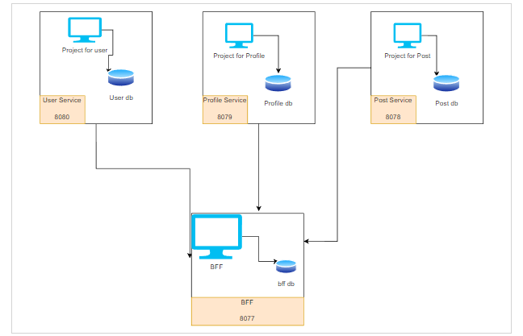
Diagram and usage
It is important to have a sketch and/or a diagram so as to understand what has to be done so as to always have a constructive idea of the steps.
->The User Service connects to its dedicated user database and has an entry point exposed on port 8080.
->The Profile Service operates similarly with its own database, available on port 8079.
->The Post Service manages its datastore and is open on port 8081.
->The BFF Service aggregates the functionalities and provides a singular point of communication on port 8077, interfacing with the dedicated BFF database.

Slide 6
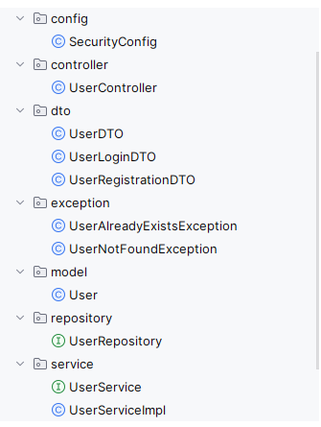
Methodology
In my architecture, I employed the Model-View-Controller (MVC) framework within each microservice to create a clear separation of concerns. I organized my code into several packages:
The config package contains my configuration classes, which set up my application's settings, including security configurations with SecurityConfig.
- In the controller package, I placed my controller classes, which act as the intermediaries handling all the incoming HTTP requests and responding accordingly.
- The service package houses my business logic. Here, services are defined to handle the core operations and business rules of my application.
- I used the model package to define my domain entities that represent the data structure within my databases.
- The dto (Data Transfer Object) package is where I structured the data that I send across the network. This is crucial for encapsulating the data in my HTTP requests and responses.
- Lastly, the repository package is where I defined my Spring Data JPA repositories. These interfaces are responsible for data persistence operations, allowing for a clean abstraction of the data layer.

Slide 7
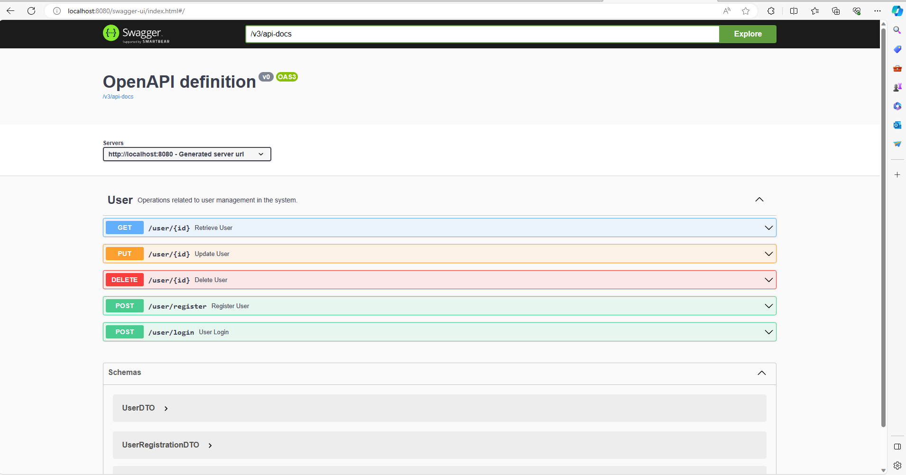
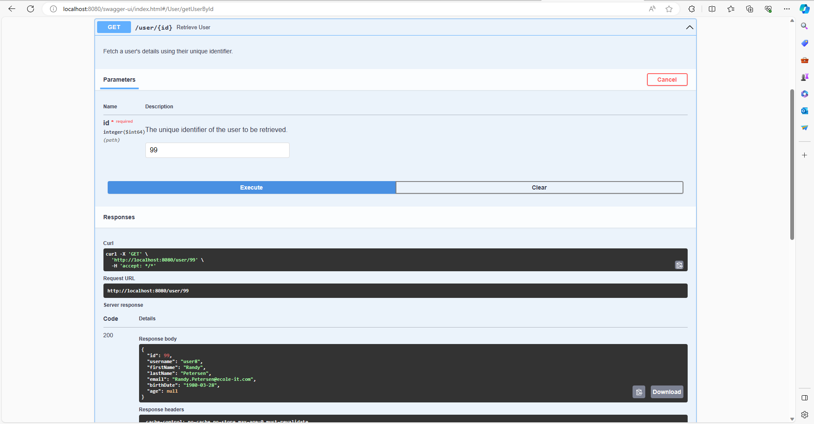
Testing Services
User Service

Slide 8
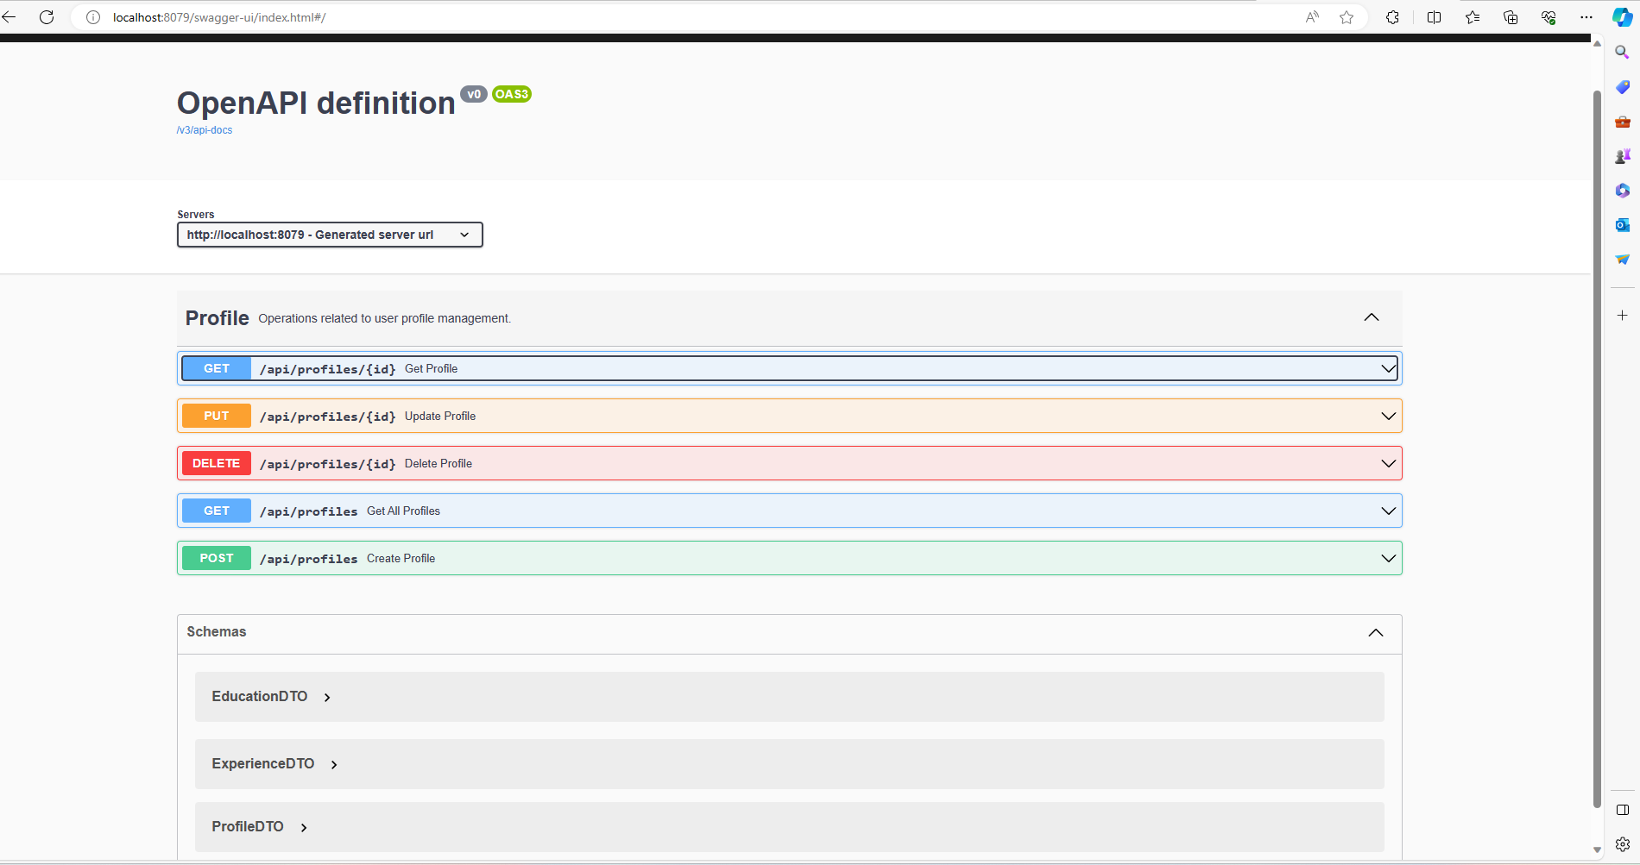
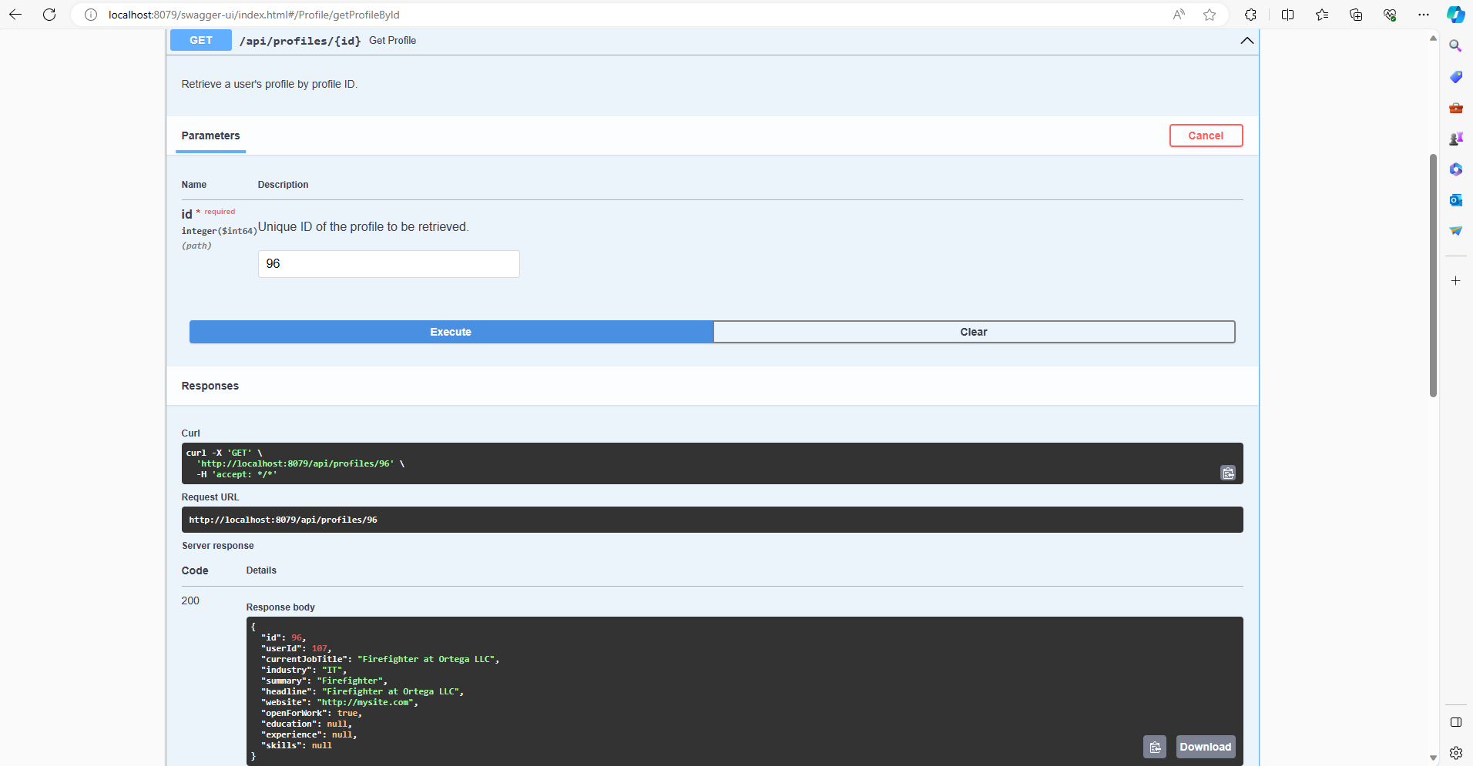
Testing Services
Profile Service

Slide 9
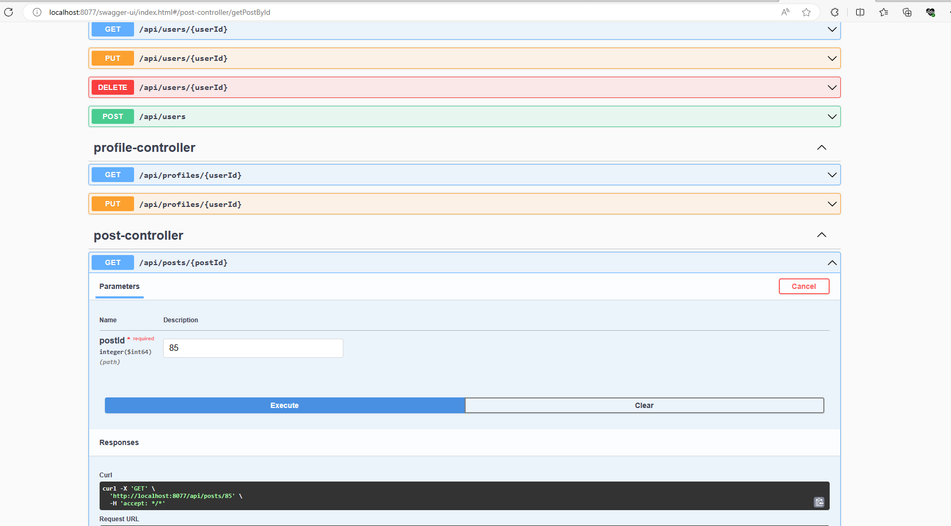
Testing Services
Post Service

Slide 10
Back-end For Front-End(BFF)
As seen earlier via my diagram , the bff acts as the center of our project .
Here , i will have to do same as other services but i will have to create 3 different variables , each having the url to a particular service.

Slide 11
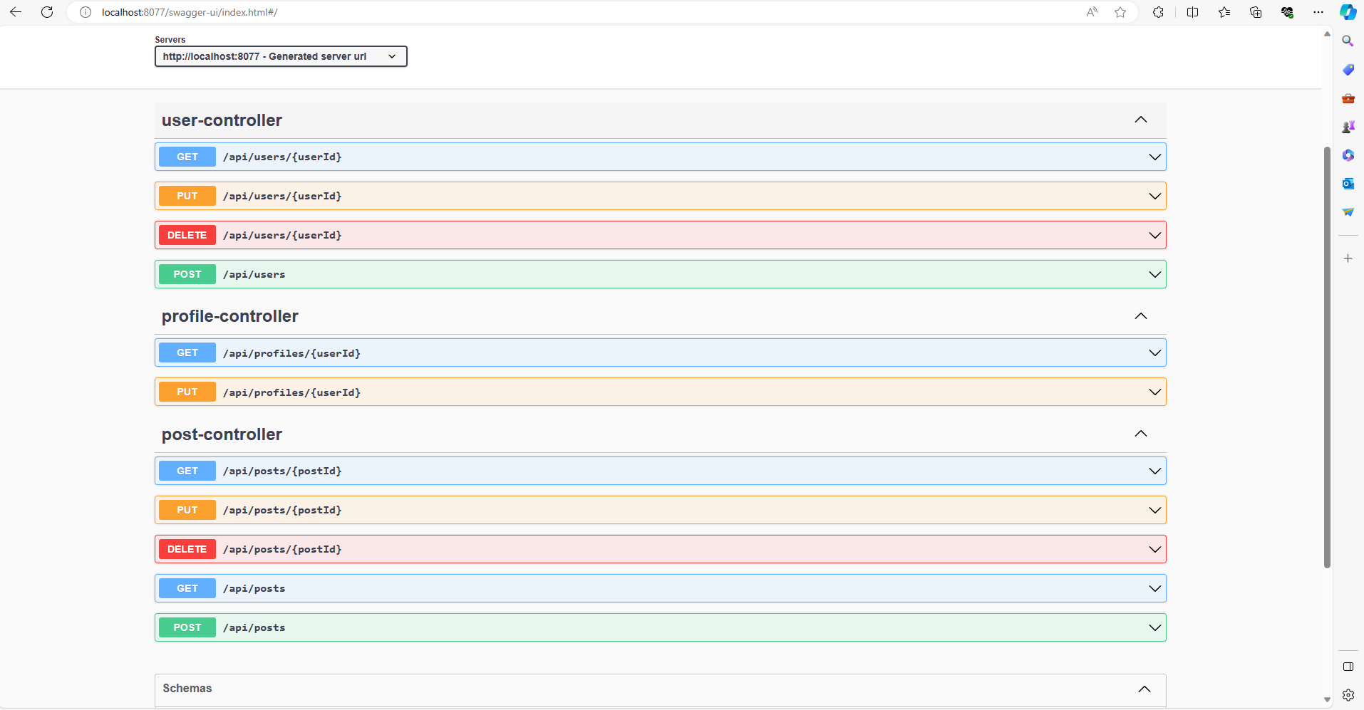
Back-end For Front-End(BFF)
Thanks to the variables usage for connections to different users , we are able to create a concrete swagger ui page for testing our crud system.

Slide 12
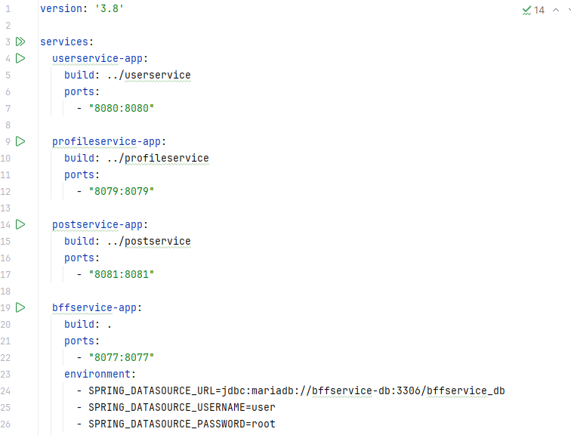
Implications of Docker
It is important to note that all services need to be in the running state before being able to use the Back for front end efficiently.
The usage of a docker-compose file is essential if we want to keep a hand on all the services at once.
NB: In this project , each service has a docker-compose file in case they wish to be tested individually.

Slide 13
Conclusion
Building an application might be a complex task but it is important to know the complexity of the project so as to know if it is worth using microservices .
Implementing Microservices is cool but using it when needed is again better.
Therefore , using microservices for a linkedin clone project is necessary.

